Slide 1
Chapter 10
Implementing Subprograms

Slide 2
Chapter 10 Topics
The General Semantics of Calls and Returns
Implementing “Simple” Subprograms
Implementing Subprograms with Stack-Dynamic Local Variables
Copyright © 2015 Pearson. All rights reserved.
1-<number>

Slide 3
The General Semantics of Calls and Returns *
The subprogram call and return operations of a language are together called its subprogram linkage *
General semantics of calls to a subprogram
  Parameter passing methods
  Stack-dynamic allocation of local variables
  Save the execution status of calling program
  Transfer of control and arrange for the return
  If subprogram nesting is supported, access to nonlocal variables must be arranged
Copyright © 2015 Pearson. All rights reserved.
1-<number>

Slide 4
The General Semantics of Calls and Returns *
General semantics of subprogram returns:
  In mode and inout mode parameters must have their values returned
  Deallocation of stack-dynamic locals
  Restore the execution status
  Return control to the caller
Copyright © 2015 Pearson. All rights reserved.
1-<number>

Slide 5
Implementing “Simple” Subprograms (static variables)*
Call Semantics:
- Save the execution status of the caller
- Pass the parameters
- Pass the return address to the called subprogram
- Transfer control to the called subprogram
Copyright © 2015 Pearson. All rights reserved.
1-<number>

Slide 6
Implementing “Simple” Subprograms (continued) *
Return Semantics:
  If pass-by-value-result or out mode parameters are used, move the current values of those parameters to their corresponding actual parameters
  If it is a function, move the functional value to a place the caller can get it
  Restore the execution status of the caller
  Transfer control back to the caller
Required storage:
  Status information, parameters, return address, return value for functions, temporaries
Copyright © 2015 Pearson. All rights reserved.
1-<number>

Slide 7
Implementing “Simple” Subprograms (continued) *
Two separate parts: the actual code and the non-code part (local variables and data that can change)
The format, or layout, of the non-code part of an executing subprogram is called an activation record
An activation record instance is a concrete example of an activation record (the collection of data for a particular subprogram activation) *
Copyright © 2015 Pearson. All rights reserved.
1-<number>

Slide 8
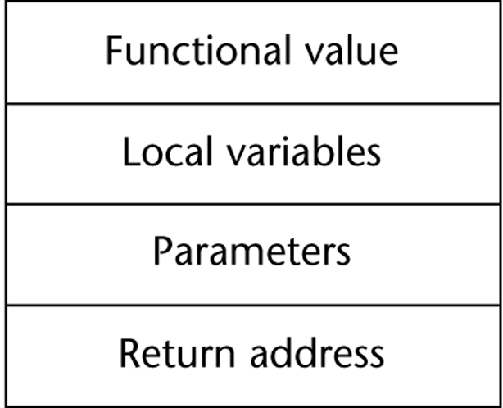
An Activation Record for “Simple” Subprograms
Copyright © 2015 Pearson. All rights reserved.
1-<number>

Slide 9
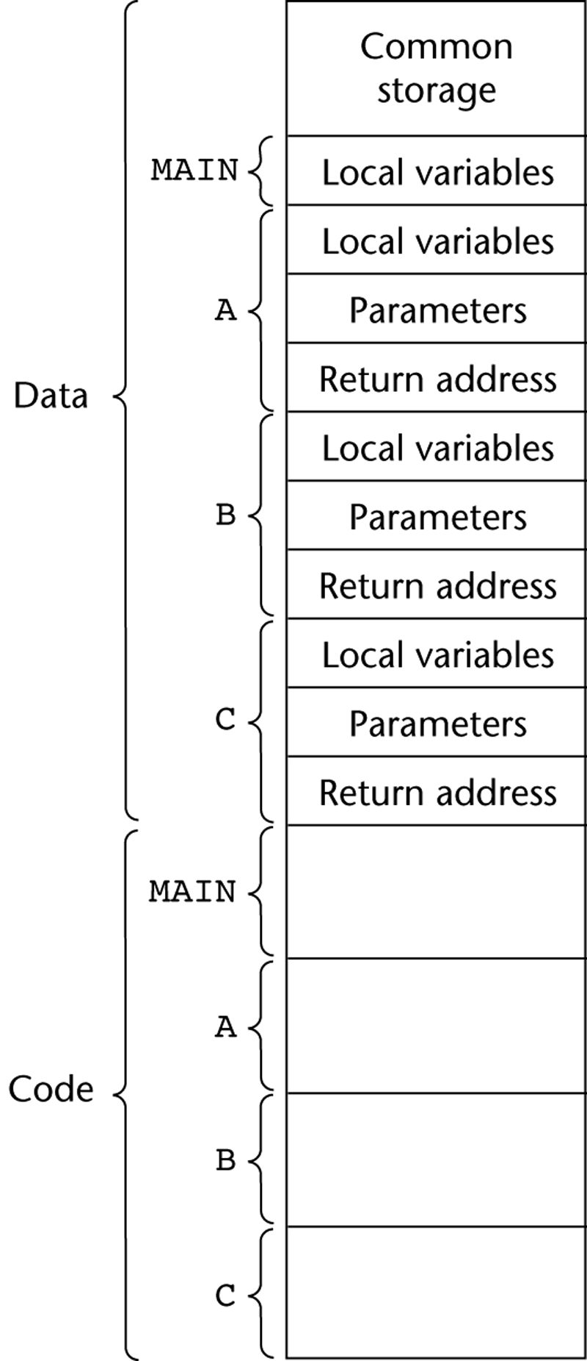
Code and Activation Records of a Program with “Simple” Subprograms
Linker is responsible for constructing this.
Find activation record instances
Load into memory with main
Give correct address for A,B,C, and any library calls
1-<number>

Slide 10
In-Class Exercise 1
What items below would be stored as data and what would be stored as code in an activation record instance for the subprogram below?
int my_fun (int x, int y)
{
static int z;
z = x + y;
return z;
}
1-<number>

Slide 11
In-Class Exercise 1
Data
  Address of next instruction in caller
  x, y, z
Code
  z = x + y
  return z
int my_fun (int x, int y)
{
static int z;
z = x + y;
return z;
}
1-<number>

Slide 12
Section Review
Activation Record
Activation Record Instance
Data / Code section of Activation Record Instance
What must happen what subprograms are called / when they return
Only static examples (known at compile time)
Linker
Copyright © 2015 Pearson. All rights reserved.
1-<number>

Slide 13
Implementing Subprograms with Stack-Dynamic Local Variables *
More complex activation record
  The compiler must generate code to cause implicit allocation and deallocation of local variables
  Recursion must be supported (adds the possibility of multiple simultaneous activations of a subprogram)
Copyright © 2015 Pearson. All rights reserved.
1-<number>

Slide 14
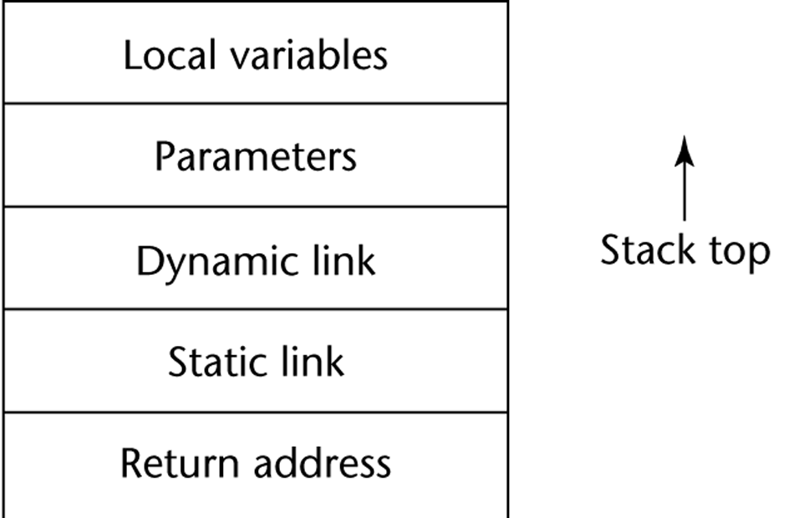
Typical Activation Record for a Language with Stack-Dynamic Local Variables *
Points to BASE of activation record instance of caller.
-static scope: provides stack trace
-dynamic scope: access to non-local variables
- This also happens to be the EP of previous activation record instance
Points to where execution should continue when subprogram is done.
Copyright © 2015 Pearson. All rights reserved.
1-<number>

Slide 15
Activation Record for fun1 (example from previous slide) *
0x001 int main() {
…
0x00A fun1();
0x00B printf(…);
}
0x110 void fun1 () {
…
}
Copyright © 2015 Pearson. All rights reserved.
1-<number>

Slide 16
Implementing Subprograms with Stack-Dynamic Local Variables: Activation Record *
The activation record format is static, but its size may be dynamic
The dynamic link points to the top of an instance of the activation record of the caller
An activation record instance is dynamically created when a subprogram is called
Activation record instances reside on the run-time stack
The Environment Pointer (EP) must be maintained by the run-time system. It always points at the base of the activation record instance of the currently executing program unit
Access to pieces of active subprogram are made by giving offsets to current EP
Copyright © 2015 Pearson. All rights reserved.
1-<number>

Slide 17
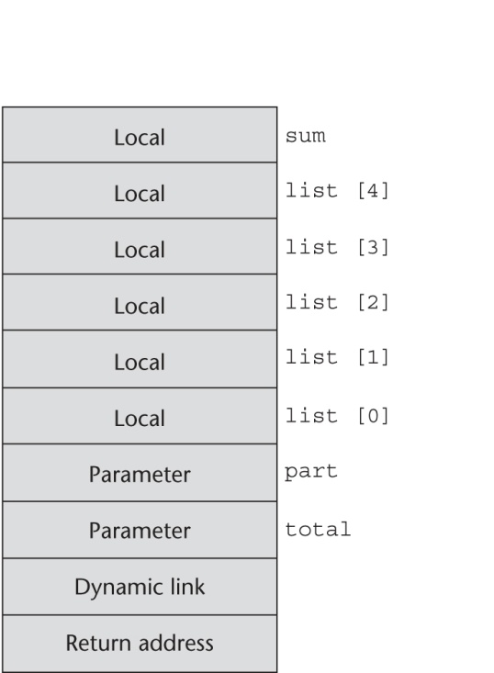
An Example: C Function
void sub(float total, int part)
{
int list[5];
float sum;
…
}
EP - 9
EP - 5
EP - 1
Active EP
1-<number>

Slide 18
Revised Semantic Call/Return Actions *
Caller Actions:
  Create an activation record instance
  Save the execution status of the current program unit
  Compute and pass the parameters
  Pass the return address to the called
  Transfer control to the called
Prologue actions of the called:
  Save the old EP in the stack as the dynamic link and create the new value
  Allocate local variables
Copyright © 2015 Pearson. All rights reserved.
1-<number>

Slide 19
Revised Semantic Call/Return Actions (continued) *
Epilogue actions of the called:
  If there are pass-by-value-result or out-mode parameters, the current values of those parameters are moved to the corresponding actual parameters
  If the subprogram is a function, its value is moved to a place accessible to the caller
  Restore the stack pointer by setting it to the value of the current EP-1 and set the EP to the old dynamic link
  Restore the execution status of the caller
  Transfer control back to the caller
Copyright © 2015 Pearson. All rights reserved.
1-<number>

Slide 20
An Example Without Recursion
void fun1(float r) {
int s, t;
...
fun2(s);
...
}
void fun2(int x) {
int y;
...
fun3(y);
...
}
void fun3(int q) {
...
}
void main() {
float p;
...
fun1(p);
...
}
main calls fun1
fun1 calls fun2
fun2 calls fun3
Copyright © 2015 Pearson. All rights reserved.
1-<number>

Slide 21
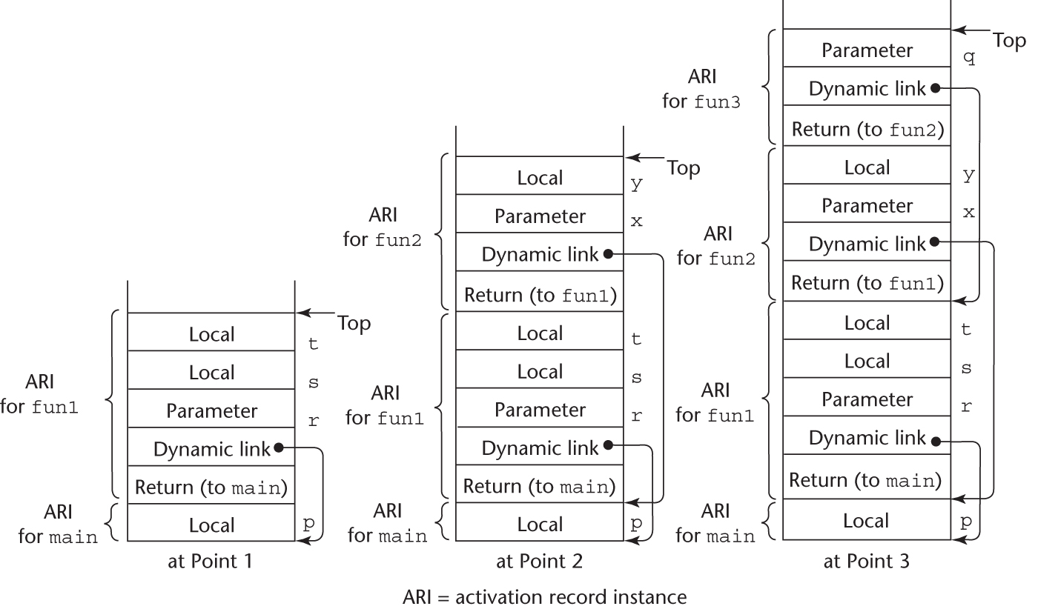
An Example Without Recursion (Stack state at various times in program execution)
Copyright © 2015 Pearson. All rights reserved.
1-<number>

Slide 22
Dynamic Chain and Local Offset *
The collection of dynamic links in the stack at a given time is called the dynamic chain, or call chain
Local variables can be accessed by their offset from the beginning of the activation record, whose address is in the EP. This offset is called the local_offset
The local_offset of a local variable can be determined by the compiler at compile time
Copyright © 2015 Pearson. All rights reserved.
1-<number>

Slide 23
In-Class Exercise 2
What is the difference between the dynamic link of an activation record instance and the return address?
What should the EP (Environmental Pointer) always be “pointing” at?
How do you calculate the address of a local variable in an activation record instance?
Copyright © 2015 Pearson. All rights reserved.
1-<number>

Slide 24
In-Class Exercise 2
The dynamic link points to the EP of the ARI that called it. The return address points to the specific line of code it should return to when a subprogram finishes executing.
The EP should always be pointing at the base address of the currect ARI. This will typically store the return address.
It is calculated as an offset to the EP.
Copyright © 2015 Pearson. All rights reserved.
1-<number>

Slide 25
Section 2 Review
Stack-dynamic local variables
Dynamic link
  Some uses
EP (Environmental Pointer)
Calculating addresses of local variables
Copyright © 2015 Pearson. All rights reserved.
1-<number>

Slide 26
Summary
Subprogram linkage semantics requires many action by the implementation
Simple subprograms have relatively basic actions
Stack-dynamic languages are more complex
Activation record instances contain formal parameters and local variables among other things
Copyright © 2015 Pearson. All rights reserved.
1-<number>

